Slide 1
CS 416 Web Programming Java Server Faces MVC details
Dr. Williams
Central Connecticut State University

Slide 2
Overview
MVC pattern – in more detail
JSF implementation of MVC
Technical underpinnings
Designing JSF MVC
Highlight interactions between model and view
View and controller interactions

Slide 3
Model
Your underlying data
Manages app data and state
Not concerned with UI or presentation
Often persists somewhere
Database or network store
Same model should be reusable, unchanged in different interfaces

Slide 4
View
What the user sees
Present the model to the user
Desktop view/mobile view
Bar chart, pie chart, table
Allows user to manipulate data
Does not store any data
Easily reusable and configurable to display different data

Slide 5
Controller
Glue that makes app unique
Intermediary between Model & View
Updates the view when the model changes
Updates the model when the user manipulates the view

Slide 6
Controller cont.
Typically where the app logic lives
Not the business logic
In MVC this sometimes requires thought
Model makes business decisions
Controller what to display (which view) based on decisions
Sometimes this gets a little cloudy as we will see later
View how to display that perspective

Slide 7
Why use an MVC model
Just like you can have “spaghetti” java programs you can have “spaghetti” web apps (yuck!!)
Clear responsibilities make things easier to maintain
Avoid having one monster class that does everything
Separating responsibilities leads to reusability
By minimizing dependencies, you can take model or view class already written and use it elsewhere
Think of ways to write less code

Slide 8
Communication and MVC
How should objects communicate?
Which objects know about one another?
Model
Example: Customer class
Not aware of views or controllers
Note this does not mean methods aren’t created for use by views in the generic sense
Typically the most reusable
Communicate generically using
Key-value observing
Notifications

Slide 9
Communication and MVC
How should objects communicate?
Which objects know about one another?
View
Example: Table view of customers
Not aware of controller flow/controller context
Also tends to be reusable
Communicate with controller using
Target-action
Delegation

Slide 10
Communication and MVC
How should objects communicate?
Which objects know about one another?
Controller
Knows about model and view objects
Knows and manages application context (brains of the application)
Manages relationships and data flow
Typically app-specific
Rarely reusable

Slide 11
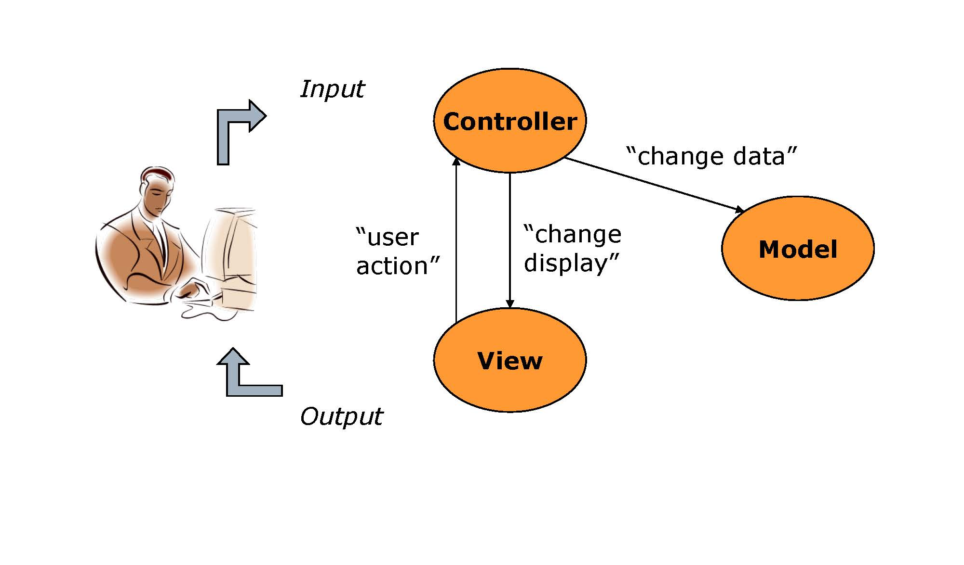
Basic interactions in MVC

Slide 12
Mechanics of Basic MVC
Setup
Instantiate model
Instantiate view
Execution
View recognizes event
View calls appropriate method on controller
Controller accesses model, possibly updating it
If model has been changed, view is updated (via the controller)

Slide 13
View Controls - Events
View objects that allows user to initiate some type of action
Respond to variety of events
Value changed
Editing
Mouse over
Clicks

Slide 14

Controls – Delegation
When an event occurs, controller called to return and/or update content
Search:
John
Key up
Get Results( )
Controller

Slide 15
Controls – Target/Action
When an event occurs, an action is invoked on the controller to decide based on context what view to display next
Login
Click
Authenticate( )
Controller

Slide 16
Controls – Persisting
When an event occurs, controller responsible for persisting if necessary
UI Element
App Server data
Event
Database
Event Occurred( )
Controller

Slide 17
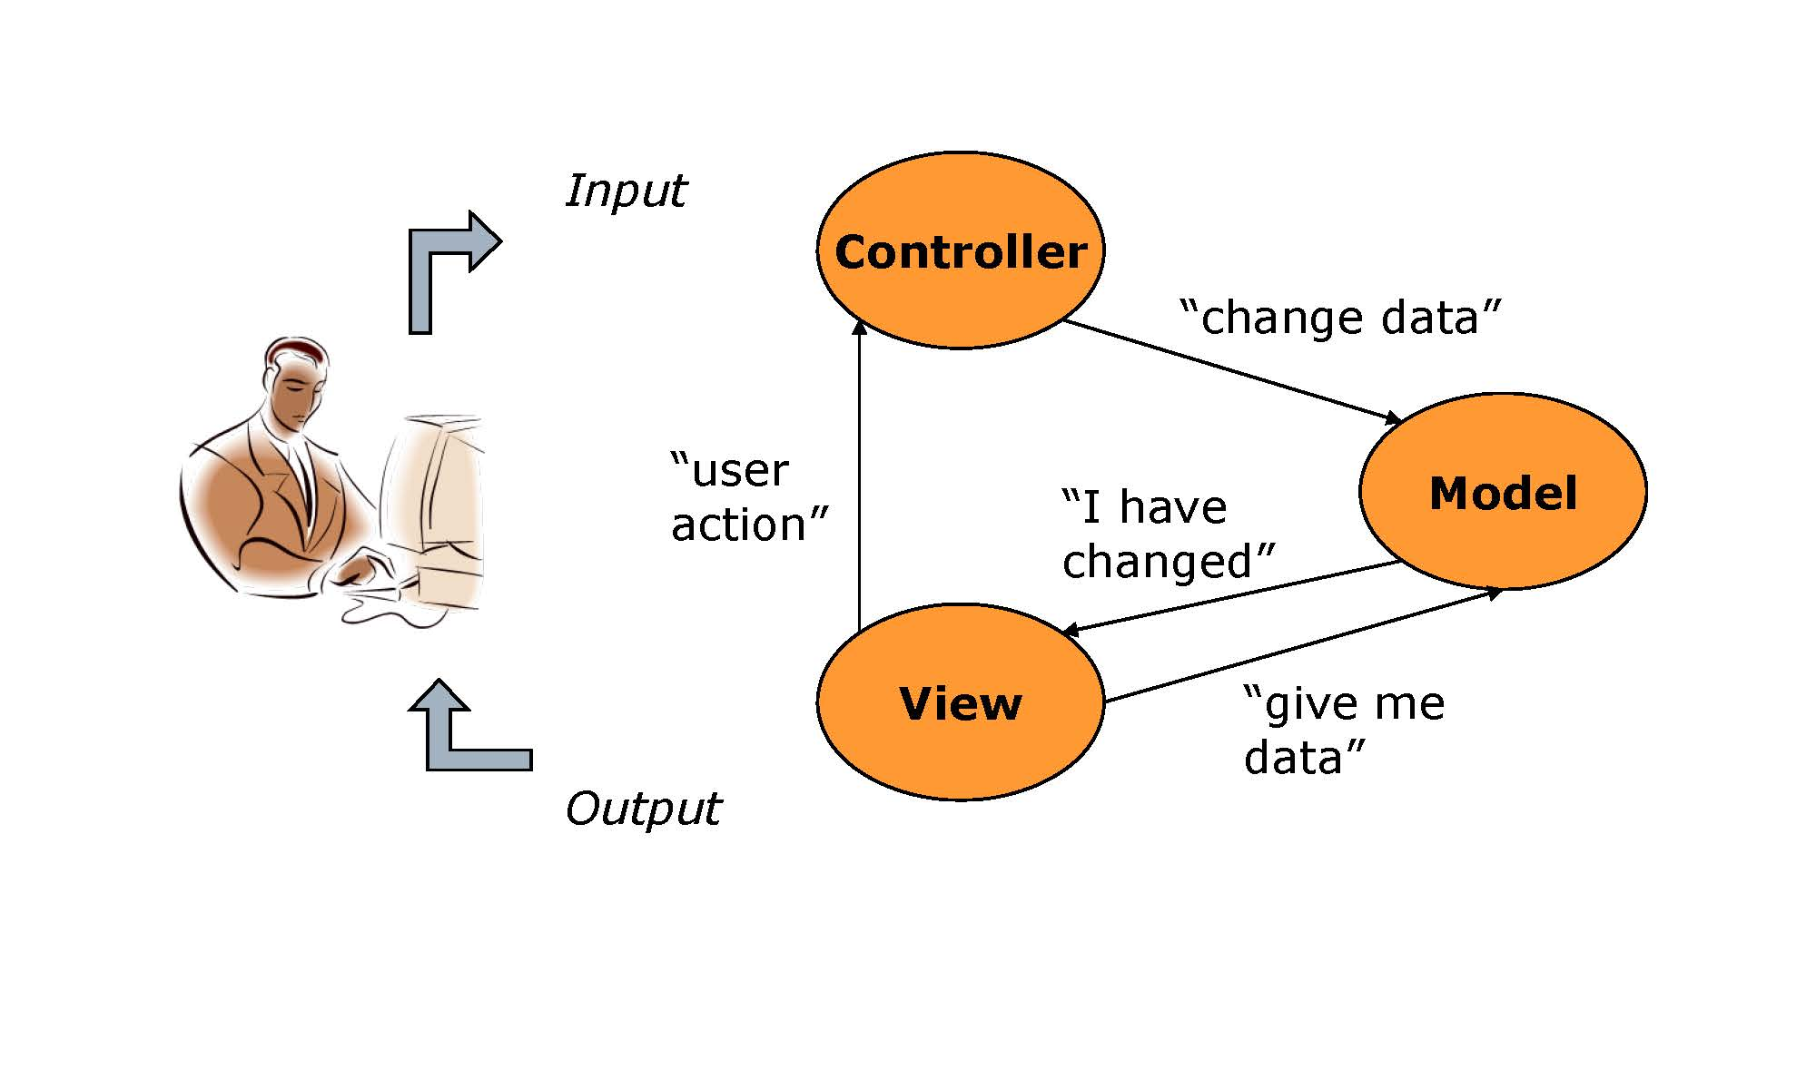
Extended Interactions in MVC

Slide 18
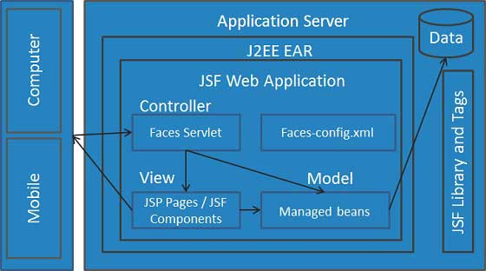
JSF - MVC technical architecture

Slide 19
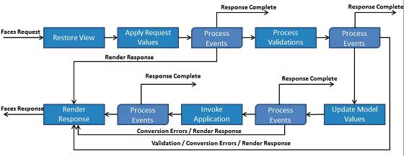
JSF Application lifecycle
Six phases which are as follows
Restore view phase
Apply request values phase; process events
Process validations phase; process events
Update model values phase; process events
Invoke application phase; process events
Render response phase

Slide 20
Phase 1: Restore view
JSF begins the restore view phase as soon as a link or a button is clicked and JSF receives a request.
During this phase, the JSF builds the view, wires event handlers and validators to UI components and saves the view in the FacesContext instance. The FacesContext instance will now contains all the information required to process a request.

Slide 21
Phase 2: Apply request values
After the component tree is created/restored, each component in component tree uses decode method
extract its new value from the request parameters. Component stores this value.
If the conversion fails, an error message is generated. This message will be displayed during the render response phase, along with any validation errors.
If any decode methods / event listeners called renderResponse on the current FacesContext instance, the JSF moves to the render response phase.

Slide 22
Phase 3: Process validation
During this phase, the JSF processes all validators registered on component tree. It examines the component attribute rules for the validation and compares these rules to the local value stored for the component.
If the local value is invalid, the JSF adds an error message to the FacesContext instance, and the life cycle advances to the render response phase and display the same page again with the error message.

Slide 23
Phase 4: Update model values
After the JSF checks that the data is valid, it walks over the component tree and set the corresponding server-side object properties to the components' local values. The JSF will update the bean properties corresponding to input component's value attribute.
If any updateModels methods called renderResponse on the current FacesContext instance, the JSF moves to the render response phase.

Slide 24
Phase 5: Invoke application
During this phase, the JSF handles any application-level events, such as submitting a form / linking to another page.

Slide 25
Phase 6: Render response
During this phase, the JSF asks container/application server to render the page if the application is using JSP pages. For initial request, the components represented on the page will be added to the component tree as the JSP container executes the page. If this is not an initial request, the component tree is already built so components need not to be added again. In either case, the components will render themselves as the JSP container/Application server traverses the tags in the page.
After the content of the view is rendered, the response state is saved so that subsequent requests can access it and it is available to the restore view phase.

Slide 26
Running example - car sales application
Basics
Enter car information
Make
Owner information
Mileage
Based on information determine application flow
Context driven
Business driven

Slide 27
MVC - Controller
Controller is responsible for the tracking context, flow of the application and persistence
The JSF framework does this through the command button (<h:command>)
Framework for application flow
Multiple methods allowing developer to choose one appropriate to task

Slide 28
Controller setup
The command button (<h:command>)
Action attribute triggers controller interaction
JSF framework control
Config file
Managed bean – Controller should not be the model
Interaction of the two
Designed with three primary goals
Separate flow from JSF page itself
Integrate request context with model (managed beans)
Simplify controller development for common cases (KISS)

Slide 29
Control options
Auto navigation
Implicit navigation
Conditional navigation
Managed Bean
Auto navigation – JSF page
<h:commandButton action="page2" value="Page2" />

Slide 30
auto navigation – managed bean simple
<h:commandButton action="#{navigationController.moveToPage2}" …
Create manged bean
@ManagedBean(name = "navigationController")
@RequestScoped
public class NavigationController implements Serializable {
public String moveToPage2(){
return "page2";
}
}

Slide 31
Business logic
Business Logic - encodes the real-world business rules that determine how data can be created, displayed, stored, and changed
Business logic rules do not belong on controller
Car sale example
Example rule
The rules on selling a car vary based on state, in order to be sold
Cars sold in NY and CA must have additional forms completed for joint ownership
Cars sold in CA must have a special emissions check completed
In actual business case there are over 50 such variations based on state
This is business logic

Slide 32
Business logic and simple navigation
Rather than having controller determine…
Have model determine if business rules are met
Have control decide flow if they are
Logically
On submit
Is model valid?
YES – Go to next page
NO – Go someplace else

Slide 33
Implicit navigation – Simple rule (navigationEx2)
Bind to model
<h:commandButton action="#{car.valid()}“
Navigation rules in faces-config.xml
<navigation-rule>
<from-view-id>navigationEx2.xhtml</from-view-id>
<navigation-case>
<from-outcome>valid</from-outcome>
<to-view-id>purchaseComplete.xhtml</to-view-id>
</navigation-case>
<navigation-case>
<from-outcome>invalid</from-outcome>
<to-view-id>navigationEx2.xhtml</to-view-id>
</navigation-case>
</navigation-rule>

Slide 34
Car sale example… (navigationEx3)
State rules – business – let model decide
Note – the information that needs to be considered for the business rules is business rules
Example options on a particular form vary by state
Rather than have a different JSF page for each state have conditional elements controlled by model
Example – Model knows which states matter

Slide 35
Car sale example –rules
Enhancing flow
Logic results in more than yes/no
Controller direct flow based on model
Additional context criteria
Additional rule
If car has over 100k miles send to another reseller
Collection of useful information
Questionable – Not intrinsic to business logic, conditional flow may be good solution

Slide 36
Conditional navigation – config (navigationEx3)
Bind to model
<h:commandButton action="#{car.specialRules}“
Config
<from-view-id>navigationEx3.xhtml</from-view-id>
<navigation-case>
<if>#{car.numberOfMiles &gt; 100000}</if>
<to-view-id>highMileageCarSales.xhtml</to-view-id>
</navigation-case>
<navigation-case>
<from-outcome>none</from-outcome>
<if>#{customer.needsOwnerInfo}</if>
<to-view-id>getOwnerInfo.xhtml</to-view-id>
</navigation-case>

Slide 37
Car sale example
Complex control
Flow dictated by view context
Flow dictated by model context
Persistence

Slide 38
Implicit navigation – managed bean complex car sales
Controller
rebate
rebateEarned
jointOwnership
Mileage > 100k
jointOwnershipForm
emissions
emissionsForm
highMileageCarSales
purchaseComplete

Slide 39
Design MVC
Bank is developing online mortgage application. Basic flow collect personal data, financial data, and home data then display approval/denial. 3 additional possible financial screens dependent on loan status. For home info screen some options state specific
Identify potential model
Identify psuedo methods on model
Identify views
Identify controllers
How implemented
Describe points of interaction

Slide 40
In group - Design MVC
Casino is developing online site. Players tied to profile and funds. Offer multiple electronic games. 3 game screens specific to each game, flow is specific dependent on game state. Betting same, results win page and lose page .
Identify potential model
Identify psuedo methods on model
Identify views
Identify controllers
How implemented
Describe points of interaction

Slide 41
In group - Design MVC
Design online regionalSAT exam. User data similar, but some info collected varies by region. “Pages” of exam, finish one section go to next. Final page exam questions vary by region. Scoring similar.
Identify potential model
Identify psuedo methods on model
Identify views
Identify controllers
How implemented
Describe points of interaction

Slide 42
In group - Design MVC
Design international airline purchase. Assume coming from flights selected. Gather user info page – information necessary from user varies based on departure country, if US display baggage fee warning page then continue, Gather payment info page, confirmation page dictated by ticket (coach, business, first class)
Identify potential model
Identify psuedo methods on model
Identify views
Identify controllers
How implemented
Describe points of interaction

